Slide 1


Scorer’s Clinic
March 18-19, 2017

Slide 2
Agenda
Goals of clinic
Scorer’s mission
The basics
Before the tournament
Scoring tricks, slalom & Jump
Computer program
Questions?
Assignment

Slide 3
GoalS of clinic
KNOW THE BASICS OF SETTING UP a TOURNAMENT
GENERAL KNOWLEDGE OF SCORING AND possible ISSUES
YOU WILL STILL NEED SOME “On the job training.” Think of this as a “theory” class.
Ask questions
Be sweet and make suggestions to improve clinic

Slide 4
Scorer’s Mission
Stay organized.
Get it right.
Get it done.

Slide 5
The basics
The running order is your rundown – follow it, know it, own it
Stay ahead of the tournament (anticipate issues & needs)
Don’t wait until event is over, score as it goes
When it doubt, look it up or ask or call someone
Consult with chief judge on sticky issues
Do what you can do and move on
It’s not rocket surgery… have fun too!

Slide 6

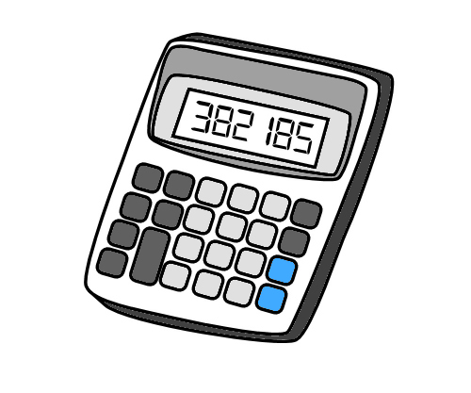
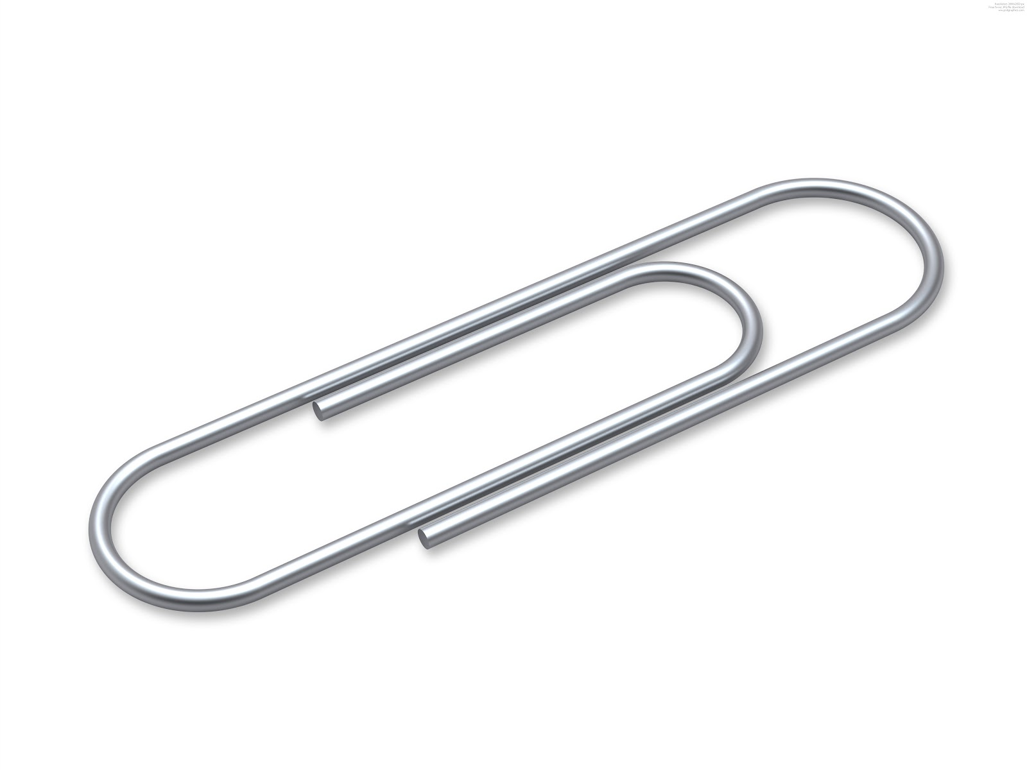


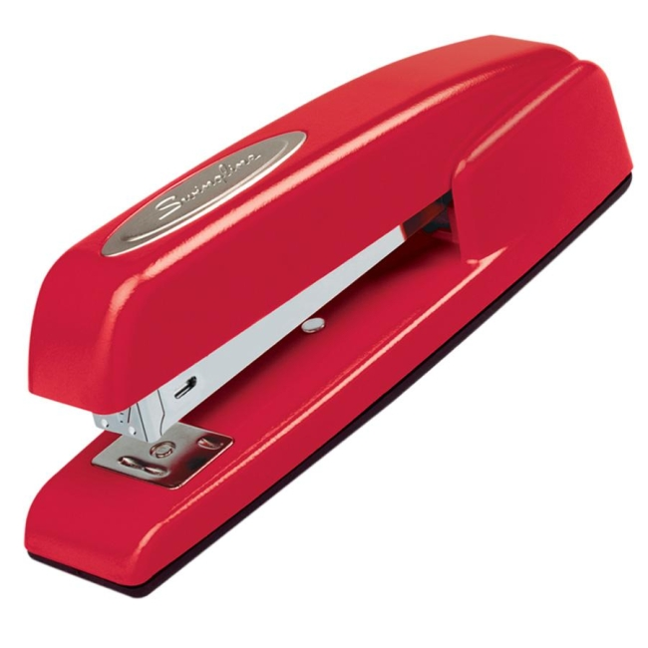



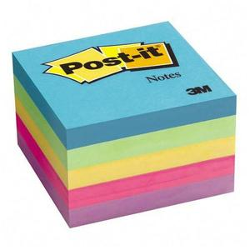
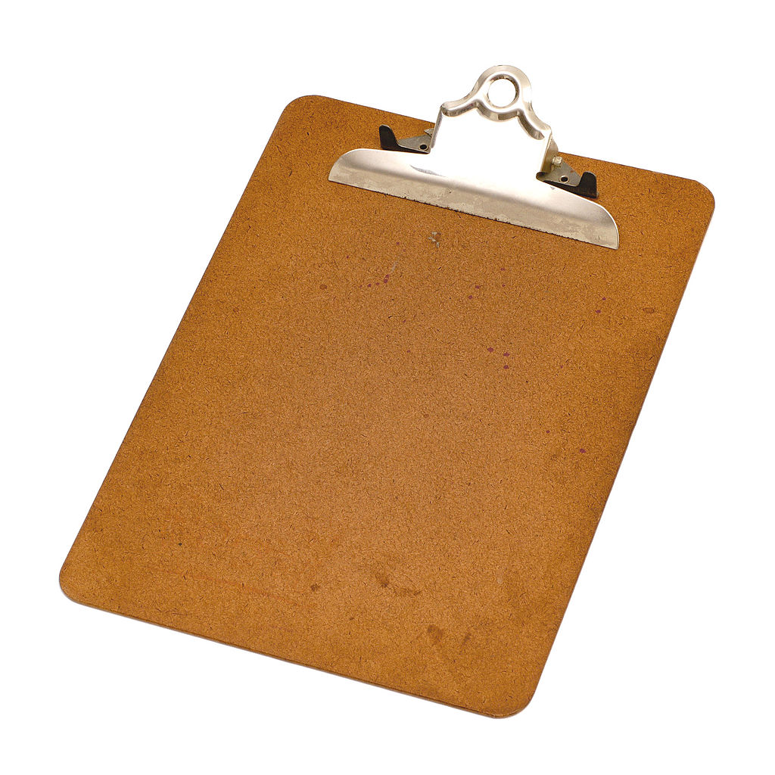
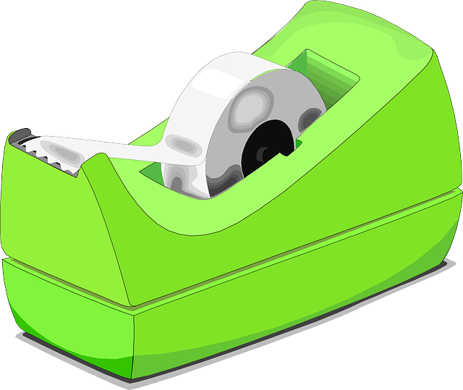


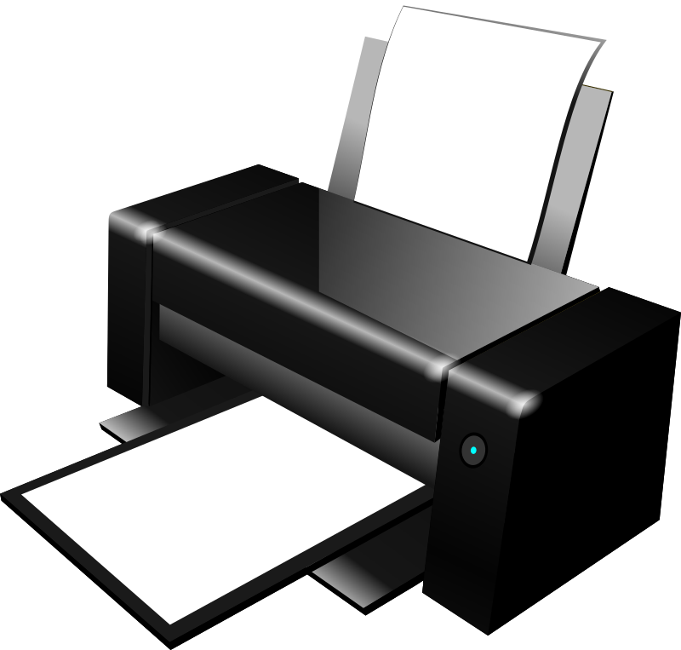
supplies
Calculator(s)
Copy paper
Pencils (sharpener)
Stapler
Paper clips
Post it notes
Thumb drive
Computer (printer/copier)
Expanding folder
currenT RULE BOOK
Clip boards (3-10)
Red erasable pens (scoring)
Green/blue pens (correction in u.s.)
Purple pens (video review in u.s.)

Slide 7
Before the tournament
Registration
Get supplies
Set up tournament in computer, enter skiers
Organize/label expanding folder
Check divisions and federation membership
Who is taking the money?

Slide 8
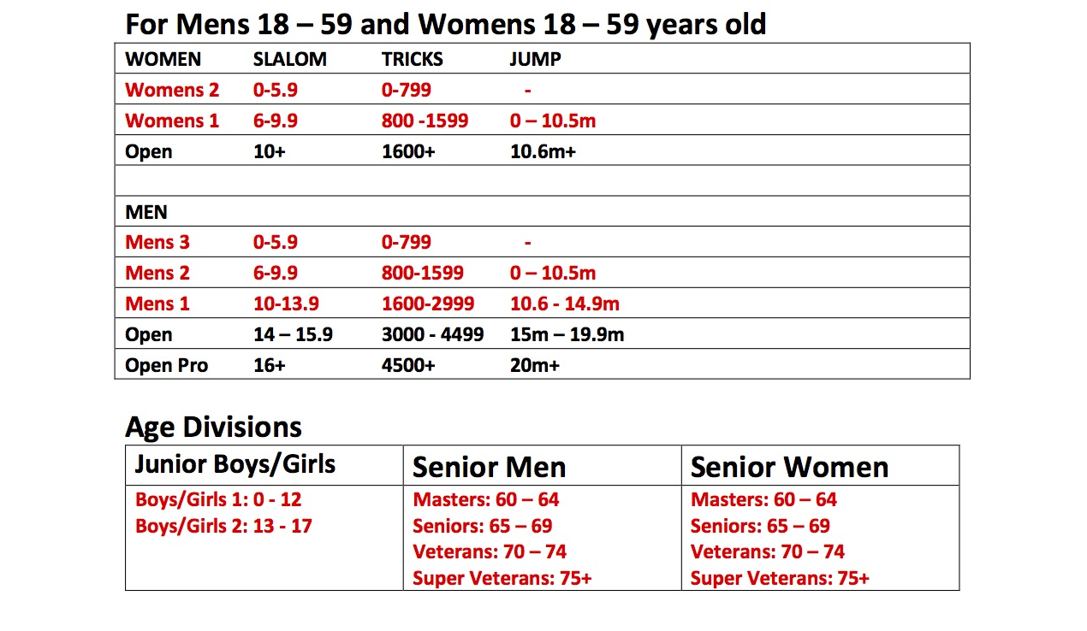
New Performance-based divisions
(for regionals, Nationals)

Slide 9
ABC RECORD DIVISIONS
BOYS 1/GIRLS 1 9 YEARS AND UNDER SLALOM & TRICKS
BOYS 2/GIRLS 2 10-12 YEARS INCLUSIVE SLALOM, TRICKS AND JUMP
BOYS 3/GIRLS 3 13-16 YEARS INCLUSIVE SLALOM, TRICKS AND JUMP
MEN 1/WOMEN 1 17-24 YEARS INCLUSIVE SLALOM, TRICKS AND JUMP
MEN 2/WOMEN 2 25-34 YEARS INCLUSIVE SLALOM, TRICKS AND JUMP
MEN 3/WOMEN 3 35-44 YEARS INCLUSIVE SLALOM, TRICKS AND JUMP
MEN 4/WOMEN 4 45-52 YEARS INCLUSIVE SLALOM, TRICKS AND JUMP
MEN 5/WOMEN 5 53-59 YEARS INCLUSIVE SLALOM, TRICKS AND JUMP
MEN 6/WOMEN 6 60-64 YEARS INCLUSIVE SLALOM , TRICKS AND JUMP
MEN 7/WOMEN 7 65-69 YEARS INCLUSIVE SLALOM & TRICKS
MEN 8/WOMEN 8 70-74 YEARS INCLUSIVE SLALOM & TRICKS
MEN 9/WOMEN 9 75-79 YEARS INCLUSIVE SLALOM & TRICKS
MEN 10/WOMEN 10 80 AND OVER SLALOM & TRICKS
OPEN MEN/OPEN PRO/OPEN WOMEN ANY AGE SLALOM, TRICKS AND JUMP

Slide 10
A word on Registration from the wbc
This is a very important job and if done properly, can eliminate many complications for the scorers. This position does not need to be a rated official.
Be sure the skier has a current federation membership.
Enter or update the skier information and ensure they are in the proper division.

Slide 11
The Nitty gritty

Slide 12
Score sheet

Slide 13
Be ready to go
Paperwork: Tricks & Slalom
Scoresheets printed, boat packets ready (scoresheets, pencils, shorthand sheets, sharpener)
Running orders distributed to: Chief judge, Asst. chief judge, Chief driver, Chief scorer, Dock starter, Announcer #1 Boat Judge, and posted on site
Paperwork: Jump event
Distribute running orders for each boat.
Boat Forms to each boat judge and time adjudicator (one form used by both) with clipboard, pencil and running order for each boat.
Computer/Recorder Form to computer operator and recorder (one form can be used by both) with clipboard, pencil and running order.

Slide 14


Slide 15
Calling the sheets
One scorer should be calling the sheets while the other two scorers agree or disagree with the calls.
everyone agrees, move on.
Issues? compare sheets.
Majority rules. No majority? Go to video
Even if there are issues, score what you can and wait for judges to get out of boat to ask questions or video review

Slide 16
Scoring slalom
The scorers shall decide the crossings to be scored on the basis of a simple majority from among the judge’s sheets.
Ensure all three sheets are for the same skier.
Check for two forward passes.
Check that passes start from the same side on each score sheet
Individually scrutinize every crossing Record the score for each crossing on the sheet in the scorer’s column.
Determine the ending zone and if that was a perfect one-foot crossing or a two-foot crossing.
Add and record score for each pass and total of both passes in the appropriate boxes.
Staple or paperclip each skier’s three sheets together for future input to computer.
If a majority cannot be reached on any crossing then the sheets should be referred for video review.

Slide 17
Scoring slalom

Slide 20
Slalom rules to remember
Always be on the look out for two forward passes. Have a copy of the 25% multiplier from the rulebook for quick reference or a calculator
If you find a judge is consistently not indicating the direction of each pass then ask the Chief Judge or Chief Scorer to remind them to please circle the appropriate direction for each pass in the future.
Be familiar with the rules regarding a fall vs a bummed crossing.

Slide 21
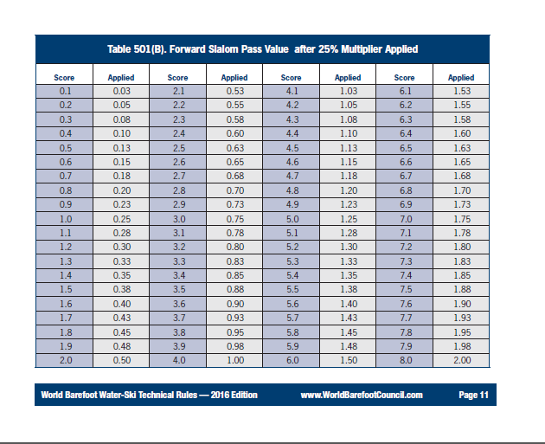

Slide 22
Scoring tricks
Many trick scores have changed as of May 1st, 2015. Many turns now carry the same value to make instant scoring easier, e.g. all 360, 540 and 720 two-foot surface turns are now 500, 800 and 1000pts respectively.
tricks to be scored on the basis of a simple majority from among the judge’s individual sheets.
Ensure all three sheets are for the same skier.
Approve or deny start trick and record score in appropriate area.
Check for any preparatory tricks so you are sure which direction the skier is facing when entering course.
It’s much quicker to score tricks after dividing them into logical groups rather then take them all individually. For example: a set of four 180 turns on 2-feet are 900pts, two 360 turns are 1000pts, etc.
Make up your own sheet with the common trick groups and refer to it when scoring tricks.
Record the score for each trick or bracket a group on the sheet in the scorer’s column.
If the pass has a lot of turns it is easier if the scorers first label each trick – with BF, FF, FB Etc. so they know which way the skier was facing before each trick started.

Slide 23
Scoring tricks
THERE ARE ONLY FOUR POSSIBLE DIRECTIONS OF A TURN:
CLOCKWISE FROM THE FRONT TO THE BACK
COUNTER CLOCKWISE FROM THE FRONT TO THE BACK
CLOCKWISE FROM THE BACK TO THE FRONT
COUNTER CLOCKWISE FROM THE BACK TO THE FRONT.
BE AWARE THAT TRICKS MAY BE REPEATED AS MANY TIMES AS THE SKIER WISHES.
BUT THEY CAN ONLY SCORE ONCE, SO KEEP YOUR EYE OPEN FOR REPEATED TRICKS.
CHECK IF REPEATED TRICKS CAN BE CREDITED AS DOWNGRADED TRICKS.
STAPLE/PAPERCLIP THE THREE EVENT FORMS TOGETHER FOR EACH SKIER FOR INPUT TO COMPUTER.

Slide 24
Crazy shorthand
(know it, love it)

Slide 26
Start points
(know what counts, what doesn’t)

Slide 27
Scorer’s responsibilities
Slalom & Tricks:
Have event forms collected from boat judges on a regular basis. Don’t wait until the end of the event.
Make a separate file of sheets that need video review.
majority problems or records should be presented to the CS or CJ for review.
Chief scorer should review score sheets to assure proper point values and correct any problems with the addition of scores before giving them to the Chief Judge for approval.
Post scores and give to announcer after being signed (with time and date) by Chief judge.

Slide 28
Scoring jump
a scorer is often assigned as a recorder for the video jump judges. They communicate with the boat after every jump and record jumps as good, a fall, or re-ride.
Record all jumps in exactly the order they happen. Don’t put rerides in another column or at the end of your list.
When a skier elects to take a reride they are annulling the affected pass. To ensure everyone later understands that pass was annulled draw a line through everything on your score sheet row of the annulled pass.
While recording distances for falls be sure to record it as ‘FALL’ and draw a diagonal line through the distance box before you record the score.
After each skier has three registered jumps draw a circle around that skiers longest successful jump.

Slide 29
Scorer responsibilities
(Jump)
Chief Scorer assigns scorer to record jump event.
Review recorder’s sheets against boat judge sheets for agreement.
Post results and give to announcer after being signed (with date and time) by Chief Judge.

Slide 30
The computer program
Required Computer Skills.
Set up tournament
Add and delete skier in tournament
Update skier information
Input Officials
Running orders compilation
Official’s boat assignments
Input scores
Update overall scores.
Print results in different formats as needed.
Print reports as needed for tournament USA Waterski and WBC.

Slide 31
Overall Scoring
Overall calculations shall be according to rulebook
Events used to calculate the overall placement in divisions shall be according to WBC rulebook
Team and individual overall points shall be determined according to rulebook
The computer does all this but watch for “Cross-dressers” (For example, if someone is open in one event but mens 3 in the other two. They will need to considered for the overall in mens 3)

Slide 32
Awards & Records
Awards: (Please assign one scorer to this if possible)
Coordinate with Tournament Director for assistance in organizing awards.
Records:
When inputting scores, watch for national and world records. a record dossier needs to be completed by the homologator if it is not generated by the computer.
TRICK & Slalom Records: individual judges sheets must be signed and copied, then associated with the record application and given to the Homologator. The Video needs to be isolated and saved so it can be reviewed and eventually submitted.
jump records: the jump set-up history, a captured image with no skier but containing the jump grid buoys and captured image of the landing must be included. Print the homologation data immediately.
It is the responsibility of the competitor to obtain all necessary paperwork and documentation for out of region or foreign federation records.

Slide 33
After the tournament
Coordinate with the chief judge and homologator on all results and reports.
reports include: Chief Safety, Chief Judge, Master Score book, Official’s work record, Boat assignments, and any other required forms in the tournament kit
scan a email all reports to USA waterski, email electronic files to Heeney@mt.net
Print chief safety and chief Judge reports before tournament so they can be filled out immediately following the tournament
Step by step instructions for submitting reports are in computer program

Slide 34
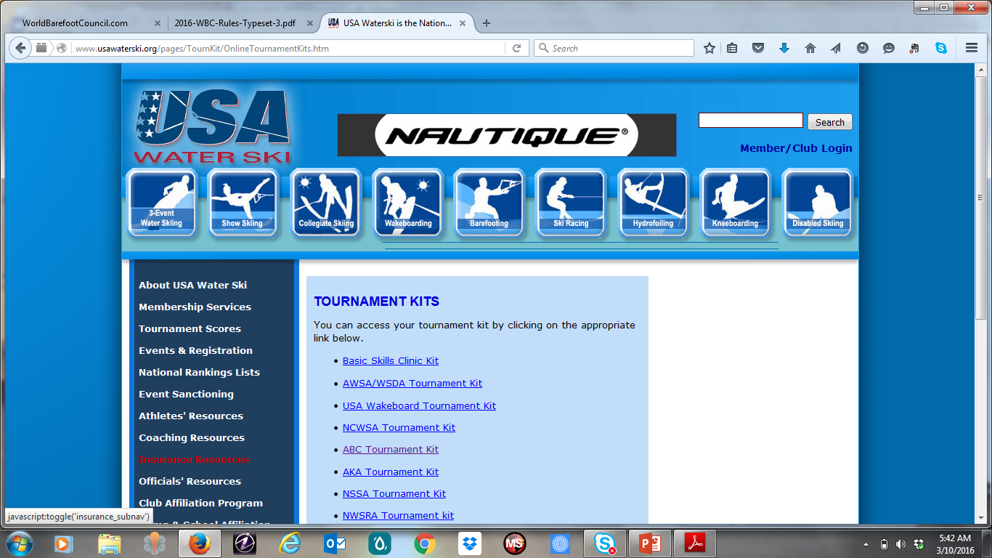
ONLINE RESOURCES

Slide 35
wbc stress reducing tips
Have a separate secured area for scoring crew only.
Insure all necessary materials are available before the start of the event.
Video review, registration, rest areas for officials, homologator equipment in other areas.
Runner specifically for scorer’s use.
Make certain event judges remain in close proximity to scorers until sheets have been scored.
Whenever you are questioned about a rule or making a ruling you should ALWAYS first refer to the rulebook.

Slide 36
Scorer’s Mission
Stay organized.
Get it right.
Get it done.

Slide 37
Questions?
(A.O.B.)

Slide 38
Assignment
Study shorthand, trick values, rulebook
Please score tricks & slalom sheets (betsy will email to you)
Email Betsybarefoots@aol.com
Deadline: April 15

Slide 39
Scorer’s Clinic
Thank you!
Score long and prosper!

