Slide 1


HOMOLOGATOR CLINIC
2017

Slide 2
Agenda
Goals of clinic
Homologator’s mission
The Basics
The Nitty Gritty
Questions?
Assignment

Slide 3
Goals of Clinic
KNOW THE BASICS of what it takes to be a barefoot homologator.
GENERAL KNOWLEDGE of homologation AND possible issues.
YOU WILL STILL NEED some “On the job training.” Think of this as a “theory” class.
ASK QUESTIONS!

Slide 4
Homolagator’s Mission
The Homologator is in charge of all technical matters at a Barefoot Competition.
He or she is appointed to verify that all the information contained within the dossier is a true and accurate report of what happened at the competition.
The Homologator is responsible to the Chief Judge for all technical matters in Rankings List and Record Capable tournaments.
The Homologator must ensure and satisfy himself that all technical installations relating to the competition are true and accurate according to the WBC Technical Rules.

Slide 5
The Basics
The homologator shall remain in contact with the Chief Judge at all times!
The homologator needs to know all record and homologation requirements.
He or she must ensure that the technical installations are ready and waiting for the skiers.
It is the homologator's duty to check the competition site after it has been set up by the organizers.
The Homologator is responsible to certify but is not responsible for initial installation of courses or maintenance.

Slide 6
"THE BUCK STOPS WITH YOU”
The Homologator must aim for the highest possible standards. You never want a skier breaking a record and then discovering the towline was too long or the ramp too high or the timer too slow.

Slide 7
Stay Ahead of the Tournament
Once all the initial checks have been made the job doesn't end there. Constant monitoring and re‑checking is the order of the day.
Keep a track of what's happened, what's happening and what's going to happen and once equipment has been used it needs to rechecked and made ready again for the next round or next group.
Establish a system to deliver and pick up ropes and handles for each event.
Keep constant track of possible records with Chief Video and Chief Scorer.

Slide 8
RECORD CAPABLE TOURNAMENTS
Record Capable Competitions are the only competitions where Confederation and World records can be established.

Slide 9
GO TIME!
Your ultimate responsibility is when a record is broken!
Besides the paper‑work required, make sure the following criteria are adhered to:
Check with Chief Judge that all boat crews meet the necessary homologation levels.
All courses and equipment for the tournament shall be checked before the start of familiarization.
Every item on the Homologator’s worksheet must be completed and recorded, then given to the Chief Judge before the start of the tournament.

Slide 11
The Nitty Gritty

Slide 12
MEASURING LINES AND HANDLES
The Homologator must measure the tournament supplied lines and handles.
Dimensions and tolerances are listed in the rulebook and worksheets available on worldbarefootcouncil.com. Remember to have spare tow lines, leaders and handles ready in case of breakage.
For all competitions, make sure the official tow lines have been stretched before they are measured.
It is also highly recommended that the Homologator refuses slalom and jump lines that are longer than the ideal length. Accepting a maximum length line is taking a risk on behalf of the skier of having to deny a Confederation or World record.

Slide 13
TIMING DEVICES
The auto‑timer should be checked against a stopwatch.. Once they have been checked and noted on the dossier, the Homologator should mark all timing devices.
The auto‑timer must be mounted in the boat so that when the horn sounds it can be clearly heard over the engine noise by the judges.

Slide 17
TRICKS
For Tricks, skiers may provide their own lines and handles of any length and size.
A 21.5 meter homologated tow‑line (19.5m towline whenever using 2m leaders) and a 30 cm and 38 cm handle should always be available in the boat during the slalom and trick events.
Skier supplied ropes shall always be attached to the leader when using Super Fly High

Slide 18
COURSES
SLALOM & TRICK EVENTS: The buoys must be installed as per the rulebook.
The distance to the skier advisory and the driver shut down buoys should be the same distance from each end of the course. Make sure the course buoys are color-coded correctly. The use of large diameter or clusters of buoys is highly recommended for these locations.
JUMP EVENT: The 100 m Jump course must be measured accurately either by using tape measures or a theodolite. The ramp’s physical dimensions must also be checked.
It is imperative the course and buoys are aligned properly and that the course is at 90º to the front edge of the ramp. There should be at least 200 metres of run in to the course.
The jump course and video buoys should be brightly coloured and all of the same size.

Slide 19
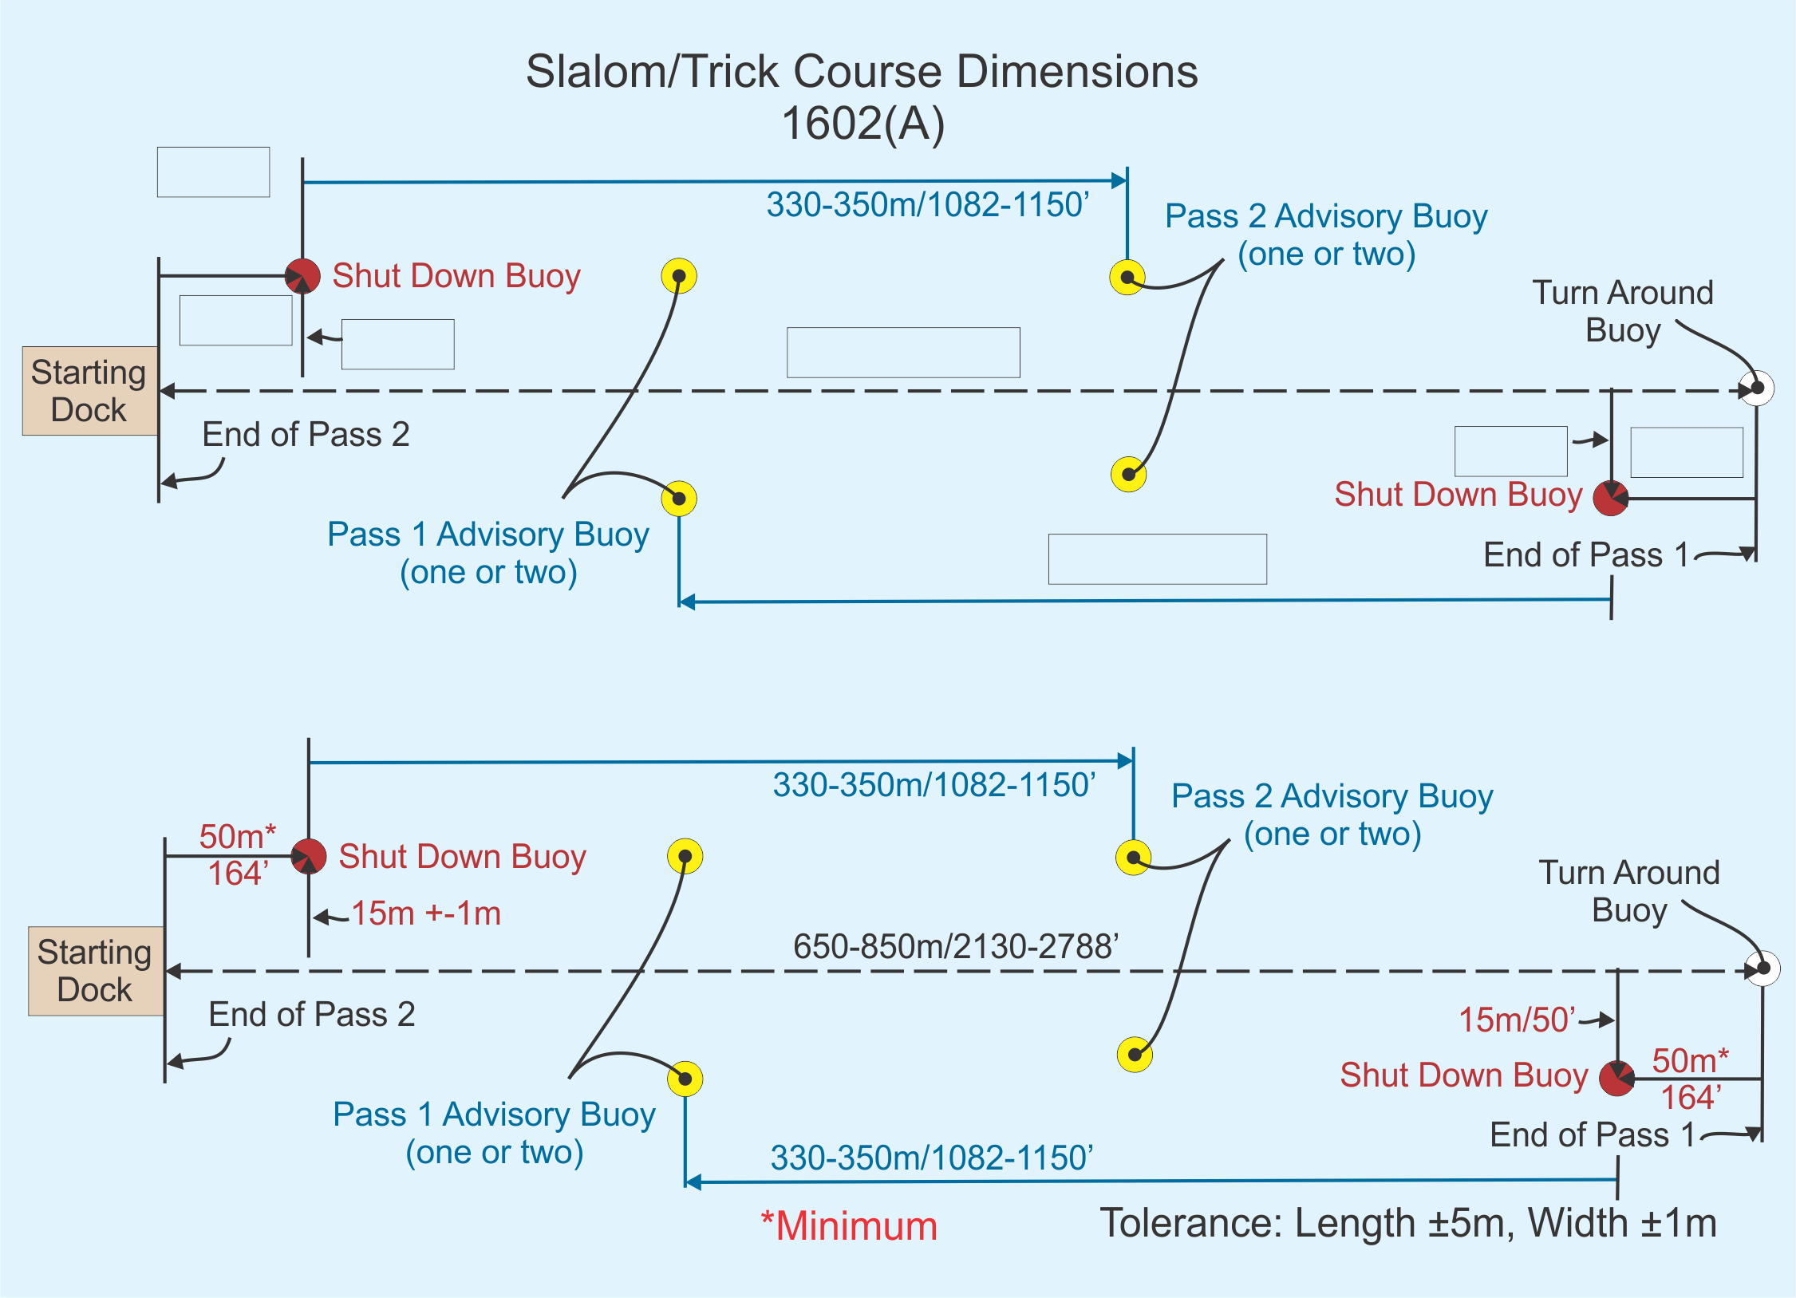
Dock shall be positions on the extended course line and must allow skier to take more than one hop, skip or step on the dock before a dock start.
Towers, between 2.5 and 5m above the water surface, should allow skiers to take more than one hop, skip or step on the dock before a dock start.
Course lines for the two passes coincide where possible.
Shutdown buoy is of a contrasting color to the skier advisory buoys.

Slide 20
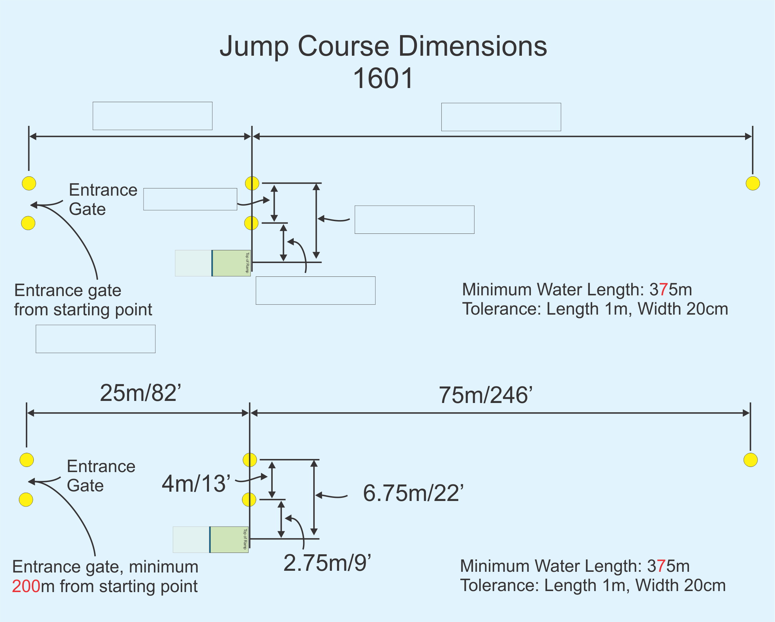

Slide 21
Overall ramp length _____.
Width of surface-tolerance marking the waterline line. __________
Length of ramp surface to center of marked water line ___________.
Actual length of exposed ramp surface _________
Width of height-tolerance waterlines _________
Actual height at top of ramp from water _________
Width of ramp ___________

Slide 22
JUMP DETAILS TO REMEMBER
Ramp is a dark color below and a light color above the waterline
Verify video jump buoy coordinates via survey or measurement.
Verify that lowest and highest readable distances are within necessary parameters to capture the lowest and highest jump scores entered in the tournament.
Check video jump program homologation levels meet tournament requirements.
Shoot a test distance with rope or tape measure and verify with computer
Ensure a list of all necessary records (World, Confed, Fed, State) is posted for scorers and computer operators
Fill out Homologation Notice form, CJ and Homologator sign and post

Slide 23
BOATS & SPEEDOMETERS
Only boats that meet the requirements in Chapter 15 in the WBC rulebook may be used for ranking list or record capability competitions.
GPS speed measurement is required for the driver. One speedometer must be facing the judge(s).
The homologator must verify with the Chief Driver the maximum boat speed possible with a full crew aboard and a 175lb/80kg skier in tow.
Check the boat can reach the maximum required speed (44.7 mph/72 kph) by the time the boat passes through the skier advisory buoy line of the slalom and tricks course and the entry gate of the jump course.

Slide 25
WAKE & TRIM SETTINGS
There can be some variation in the wake definition of tow‑boats, therefore in order to maintain the same wake definition for each and every skier, the Homologator must check that the wake definition and top speed of the boat are as per the rulebook with a full crew on board while towing a 175lb/80kg skier.

Slide 27
VIDEO
For record capability competitions all slalom, trick and jump passes must be recorded on a current technology, memory sticks, SD cards, the internet, etc. which must be made available to the Chief Judge on his request.
The Chief Judge is solely responsible for the official video of the competition.
The appointed video personnel should have sufficient memory and power supplies for that event/grouping of the competition.
In the case of a record being broken it’s the Homologator’s responsibility to ensure that a recording of the record accompanies the completed homologation dossier and judges sheets when it is sent to the records committee chairperson.
It’s mandatory for tricks and slalom the camera is located in the towboat in order to give a perspective as close as possible to the judges.

Slide 28
JUMP MEASUREMENT
See the WBC PPG for approved systems.
The Homologator should ensure that the system operator is in direct communication with the towboat, Chief Judge and Chief Scorer at all times during the jump event.
The Homologator must make that the system is reading correctly by physically measuring a test buoy with tape and comparing the result with the distance from the video system.
In the event of a record, the Homologator must ensure that the metered jump landing image and the course set-up is saved to memory and forwarded to the record review committee immediately following the tournament.
An image from the same camera set up of the video distancing buoys with no jumper should also be saved and forwarded in case a buoy is obscured in the landing frame.

Slide 29
WAS IT A RECORD?
The Homologator or Chief Scorer shall advise the Chief Judge of all potential records as soon as possible.
Make copies of scoresheets and video of potential records for the sole purpose of record review. This will allow review and ratification of records to proceed without interfering with the ongoing tournament.
Record review can be done at slow speed and the committee members are allowed to discuss their opinions.
Scores derived by the review committee are not the scores to be used for tournament placement.

Slide 30
MORE ON RECORDS
If the score given for a jump is a record, the Homologator shall make a visual positioning check of the ramp using the course buoys or indicators on shore to confirm the ramp has not moved.
The competition does not have to stop for checking the course or ramp dimensions, which the Homologator is constantly monitoring from the shore using the water-line indicators.
The rope and handle does NOT need to be re-certified and checked by the Homologator immediately following a record performance. It was certified before it entered the boat.
The Homologator shall be responsible for the on-site review of all potential records.

Slide 31
ON-SITE RECORD REVIEW
All performances in all record eligible rounds equal to or exceeding the existing record shall be reviewed in descending order until the best that can be verified is established.
While only one record can be set in any event during a tournament but what the on-site review committee feels is the highest scoring record may fail in review in the Record Committee. Because of that, any and all performances that still exceed the existing record after review must be submitted to the National or WBC Records Committee.
On site review doesn’t need be the event judges. The most qualified officials available can review the record.

Slide 32
RECORDS AT WORLD CHAMPIONSHIPS
The Chief Judge of the World Championships shall provide the Skier or Team Representative documentation necessary for substantiating any pending Federation or Confederation record set at the World Championships.
The Team Representative and any of his Confederation Council or WBC Members shall also be afforded the facilities to look at the pending Confederation or Federation record or make record verification.
The Homologator or Chief Judge shall provide the skier or team representative whatever is necessary for Federation or Confederation record review.

Slide 33
After the Tournament
Submit National and/or World Record Forms
Follow up with Records Committee
Stay in touch for any follow up questions

Slide 34
Questions?

Slide 35
Assignment
The assignment is to familiarize yourself with the jump program and how to save jump record images. (Splash Eye in So Region)
Links to Homologator Worksheets Rope Worksheet, Handles Worksheet, Jump Handles Worksheet, Jump Set Up
Link to WBC Rulebook
Comments or questions contact: oscarfootmann@hotmail.com

Slide 36
HOMOLOGATOR CLINIC
2017

